Slide 1
Image-Guided Geometric Stylization of 3D Meshes
Changwoon Choi*, Hyunsoo Lee*, Clément Jambon, Yael Vinker, Young Min Kim

Slide 2
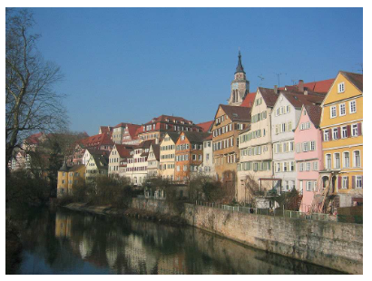
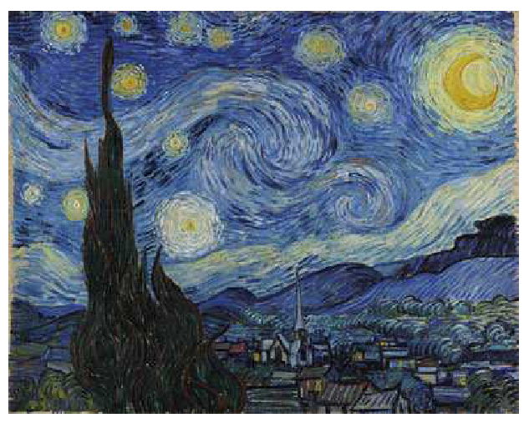
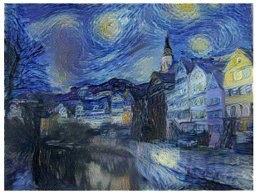
Style Transfer
Given a source image and a style image, generate stylized image
Stylized image: semantic content of the source in the given style
Source
Style
Stylized image
[1] Gatys et al., A neural algorithm of artistic style, JOV 2016

Slide 3
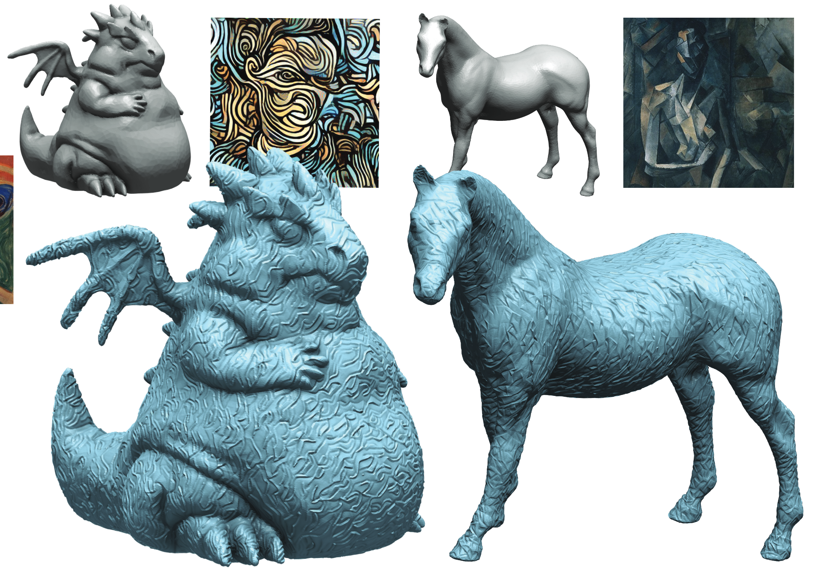
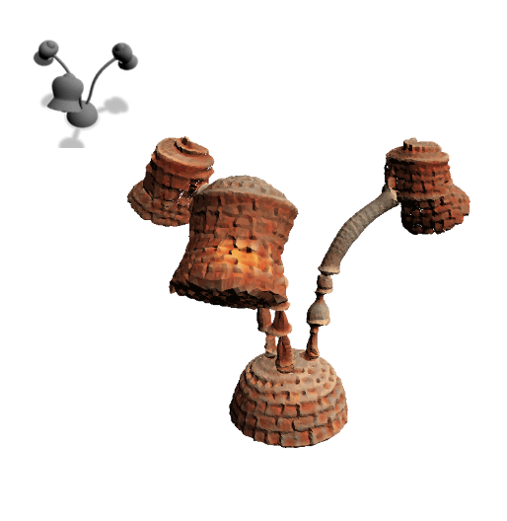
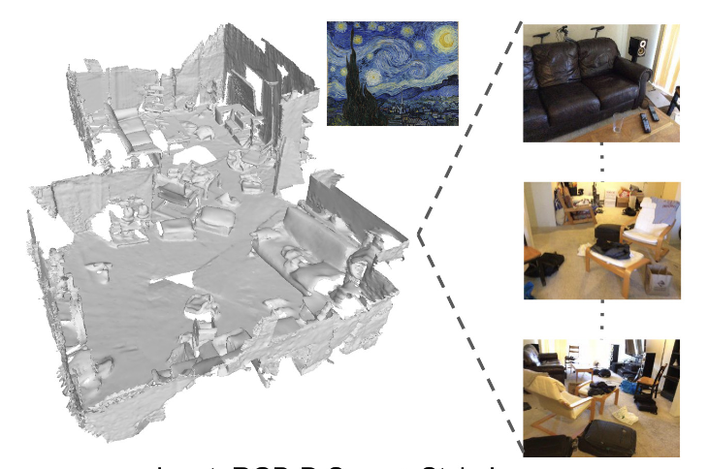
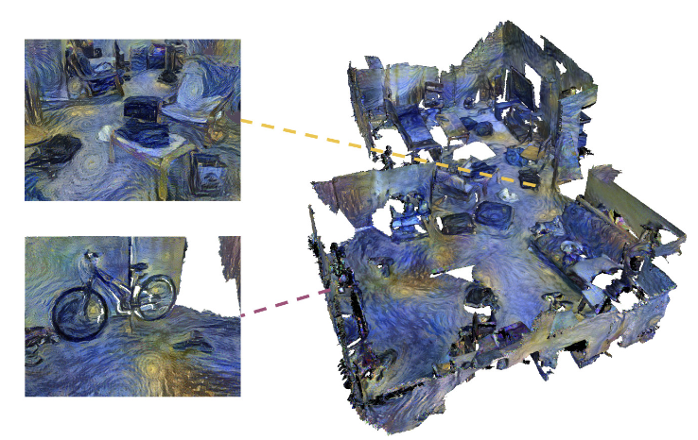
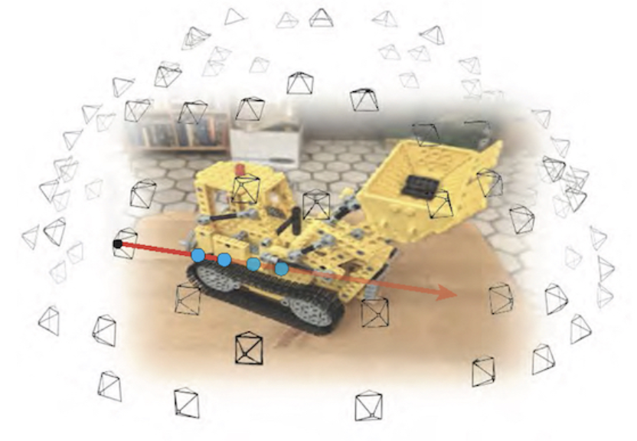
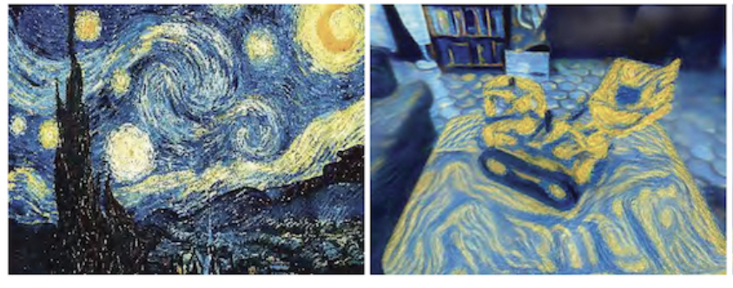
Style Transfer in 3D
Transfer reference style to source 3D scene
Image, Text
Mesh, NeRF, 3DGS, etc.
Transferring high-frequency patch statistics of color/texture
+ “Brick lamp”
Paparazzi
Text2Mesh
StyleMesh
ARF
[2] Michel et al., Text2Mesh: Text-Driven Neural Stylization for Meshes, CVPR 2022
[3] Hölein et al., StyleMesh: Style Transfer for Indoor 3D Scene Reconstructions, CVPR 2022
[4] Zhang et al., ARF: Artistic Radiance Fields, ECCV 2022
[5] Liu et al., Paparazzi: Surface Editing by way of Multi-View Image Processing, TOG 2018

Slide 4
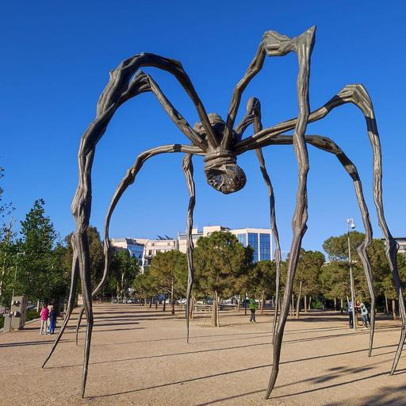
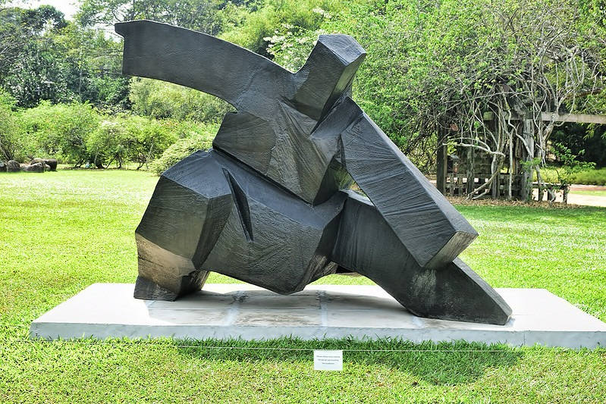
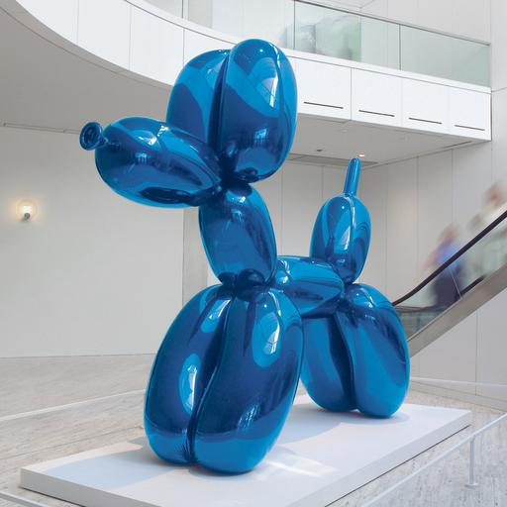

Style is not only about textures!
Geometric style
Beyond textures: style encompasses structural and geometric features
E.g., cubic and bulbous shape, irregular and organic tapering legs, sitting pose, proportion, …

Slide 5
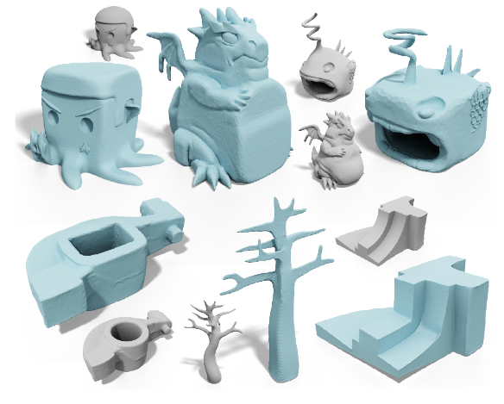
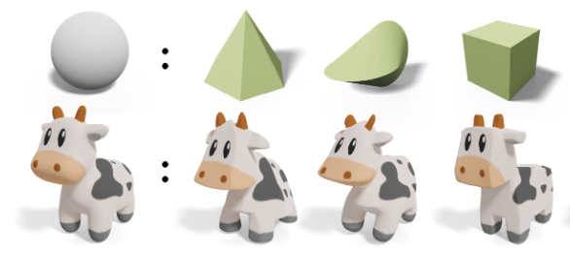
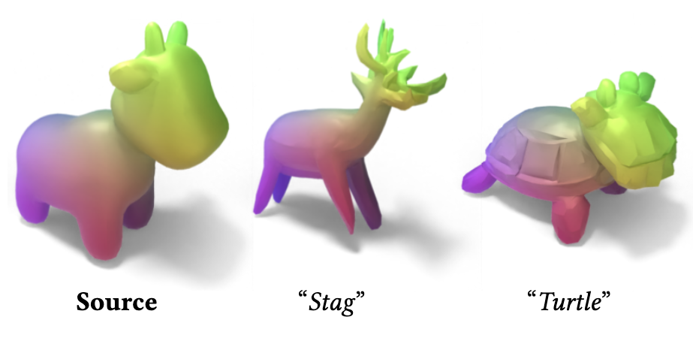
Related Works – Geometric Stylization
Previous works that tackle macro-scale geometric stylization/deformation
Text input: Ambiguous and difficult to describe and reflect user’s style intent
Minimizing hand-crafted regularization term: Limited to representing specific styles
[6] Liu and Jacobson, Cubic Stylization, TOG 2019
[7] Liu and Jacobson, Normal-Driven Spherical Shape Analogies, CGF 2021
[8] Gao et al., TextDeformer: Geometry Manipulation using Text Guidance, SIGGRAPH 2023

Slide 6
Research Goal
Deform a source 3D model to match an arbitrary reference style
Generate 3D assets directly vs. Deform existing 3D assets
Triangular mesh
Given as images

Slide 7
Method Overview
Two-stage approach
Style extraction
Can we get a style-specific optimizer by extracting an abstract representation from any provided images?
Mesh deformation
Robust optimization strategy to enable semantic-aware and large-scale deformation

Slide 8
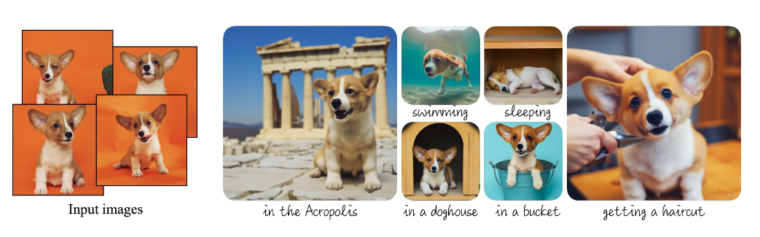
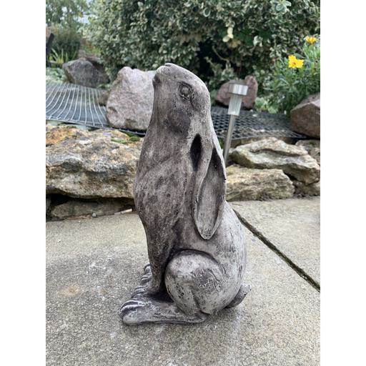
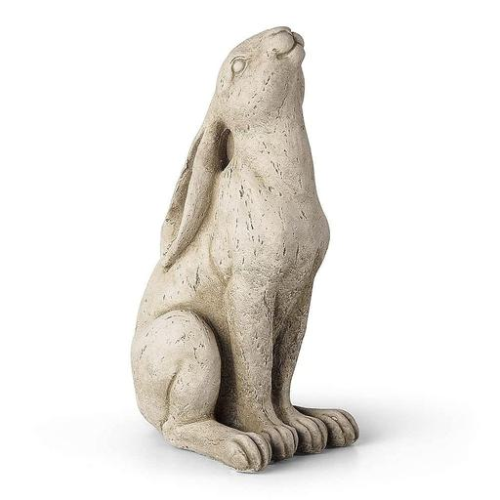
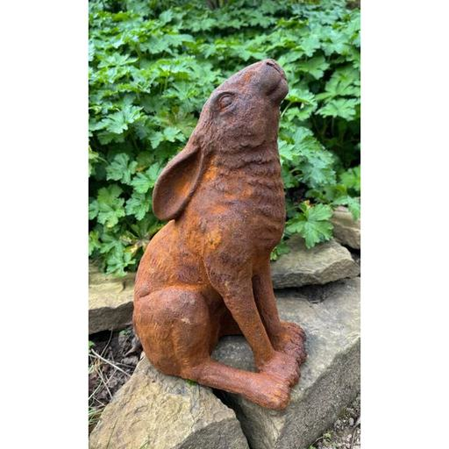
Style Extraction
Fine-tune SDXL model
DreamBooth + LoRA training with 5-10 style images
Personalized diffusion model is not only able to generate images of certain instance, but it can serve as a style-specific optimizer
LoRA weight
+
❄️
SDXL
[9] High-Resolution Image Synthesis with Latent Diffusion Models, CVPR 2022
[10] Ruiz et al., DreamBooth: Fine Tuning Text-to-Image Diffusion Models for Subject-Driven Generation, CVPR 2023
[11] Hu et al., LoRA: Low-Rank Adaptation of Large Language Models, ICLR 2022

Slide 9
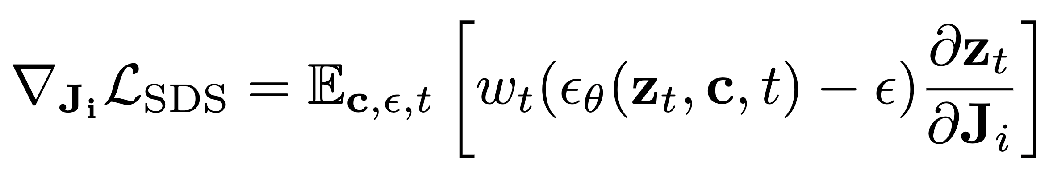
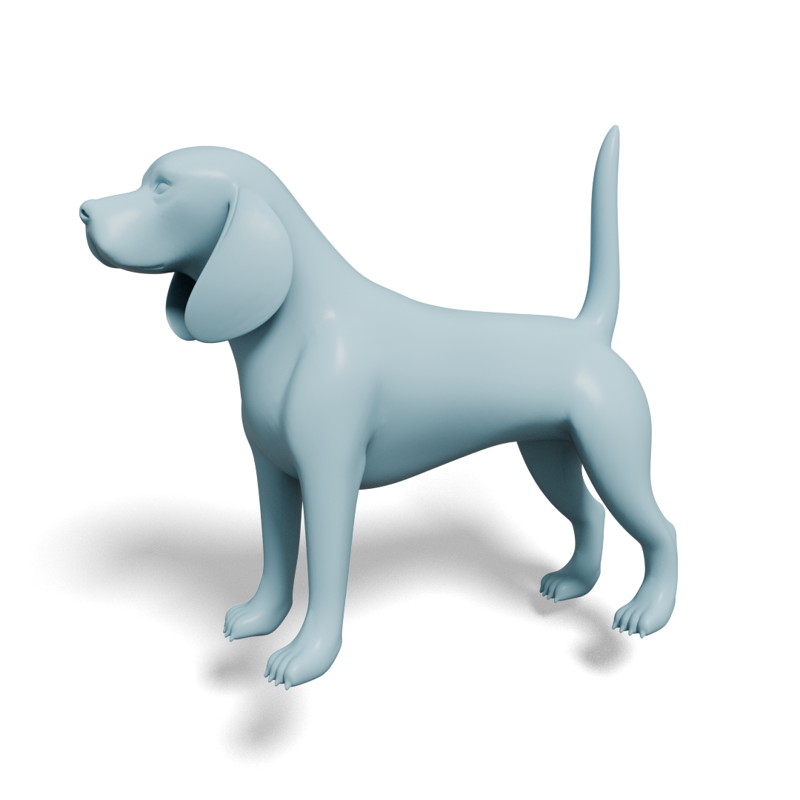
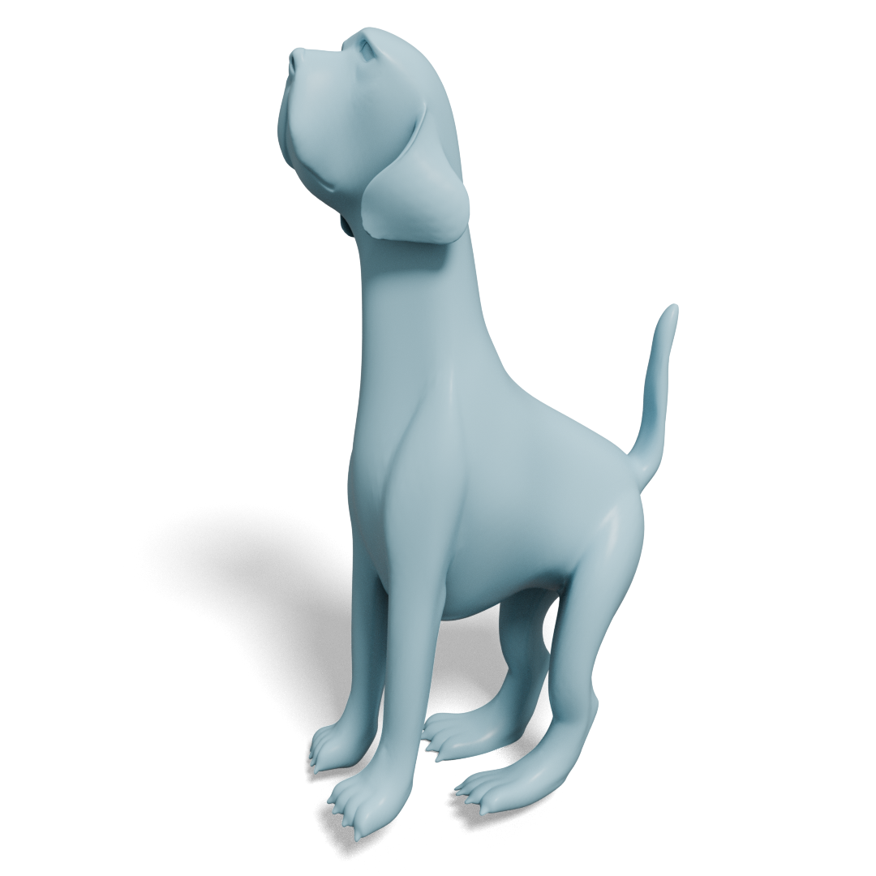
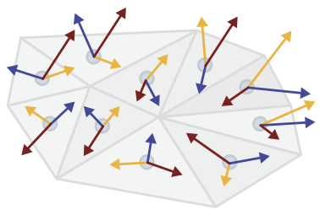
Mesh Optimization
Deform mesh by minimizing SDS Loss with personalized diffusion model
Optimize per-face Jacobian
Source mesh
+
❄️
Approx. VAE Encoder
+
SDXL
Jacobians
[12] Aigerman et al., Neural Jacobian Fields: Learning Intrinsic Mappings of Arbitrary Meshes, TOG 2022

Slide 10


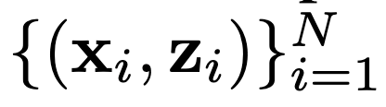



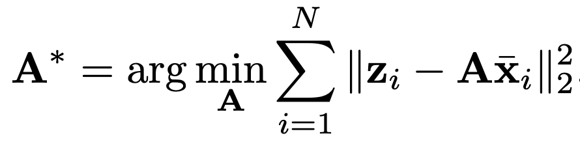
Approximated VAE Encoder
We propose a technique to approximate VAE encoder of latent diffusion model for efficient and low-variance gradient calculation
Approximate VAE encoder as a simple matrix that maps image space to latent space
Obtain N image-latent pairs
( is rendered image, is corresponding latent from SDXL VAE)
Fit via least square:

Slide 11
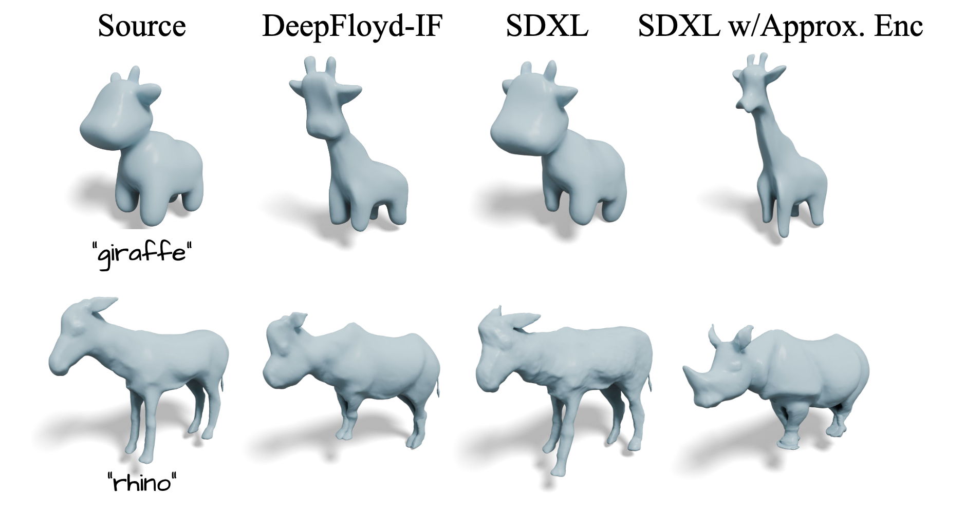
Approximated VAE Encoder
VAE encoder approximation technique is key to enable stable mesh optimization with the latent diffusion model
Unlocks the rich priors in SDXL, which exceed the capabilities of pixel-space models
[13] Kim et al., MeshUp: Multi-Target Mesh Deformation via Blended Score Distillation, 3DV 2025

Slide 12
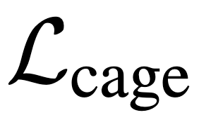
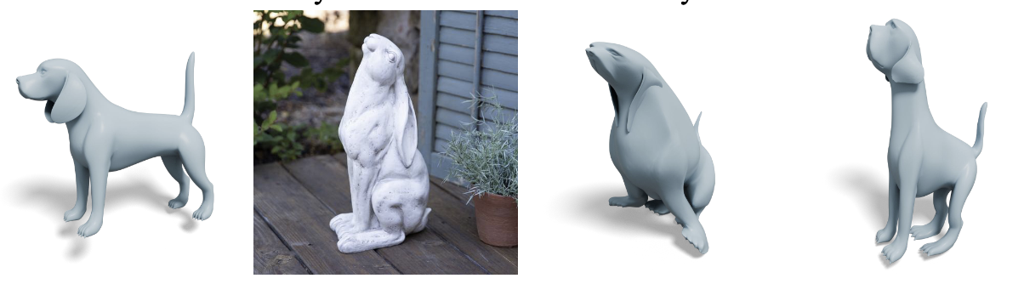
Coarse-to-Fine Optimization
When the large-scale deformation is needed (i.e., style image is significantly different from the source mesh), Jacobian field optimization deteriorate the mesh
Coarse-to-fine scheduling that enables large-scale deformation at early stage
Coarse level: cage loss which preserves locally coherent structure
Part-level decomposition of mesh can provide clues for relative semantics
Gradually increase the relative contribution of Jacobian optimization with SDS loss
Source mesh
Reference style
only
With

Slide 13
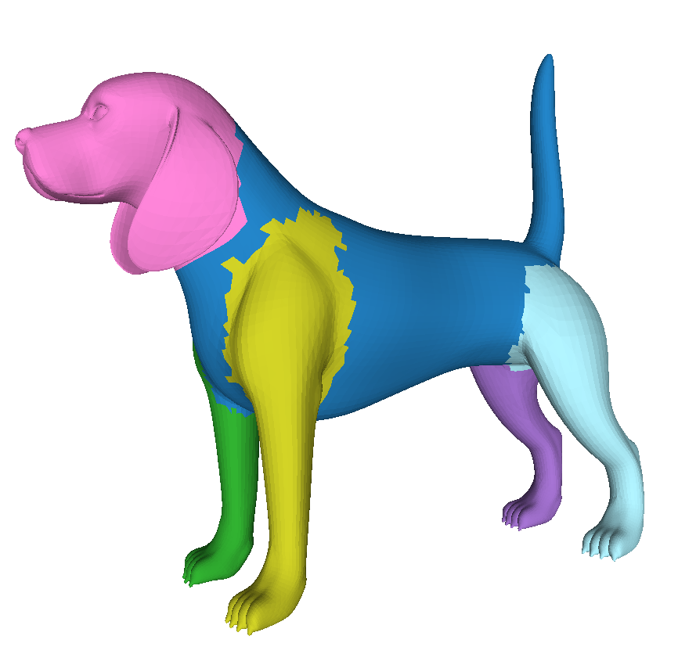
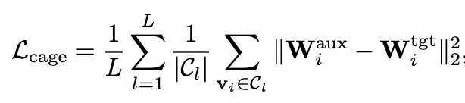
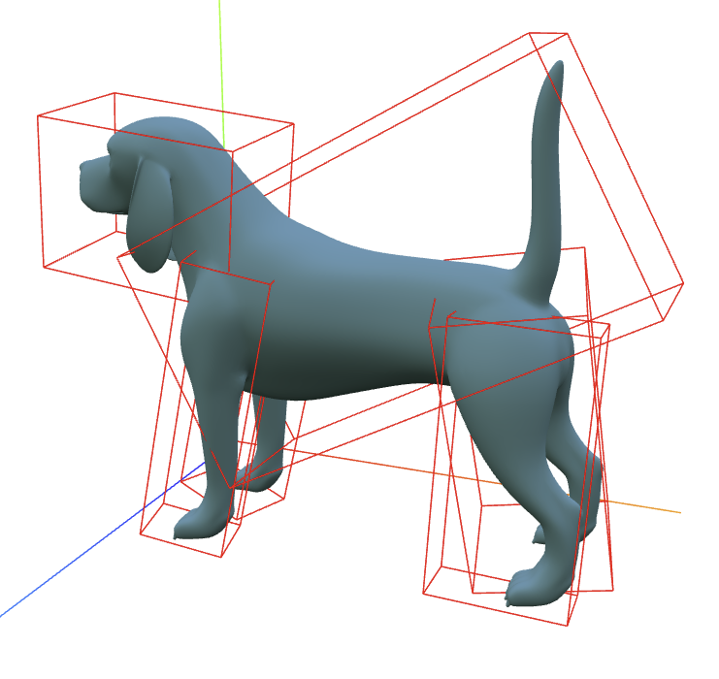
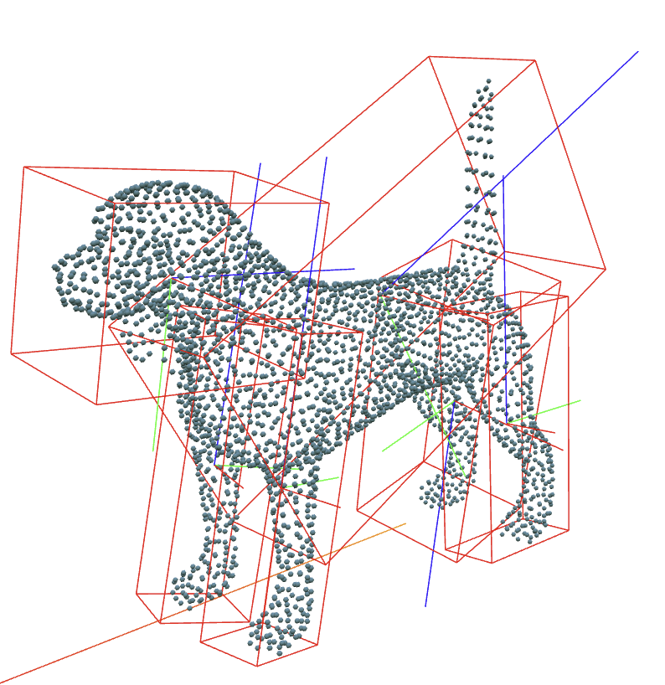
Cage-Guided Deformation
Building cage: Oriented bounding boxes of parts
Calculate SDS Loss with auxiliary mesh & update cage vertices
Only rotation, scale, translation of cuboids
Regularize cage coefficients of mesh vertices to follow those of updated cages
PartField segmentation
❄️
Approx. VAE Encoder
SDXL
+
Cages
Auxiliary mesh
[14] Liu et al., PartField: Learning 3D Feature Fields for Part Segmentation and Beyond, ICCV 2025

Slide 14
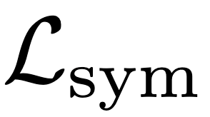
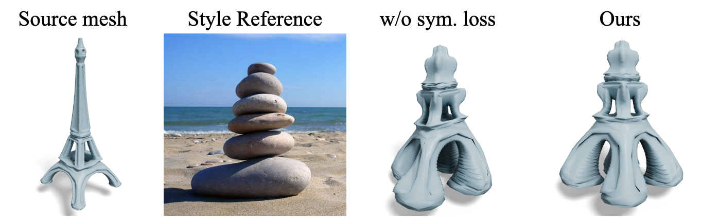
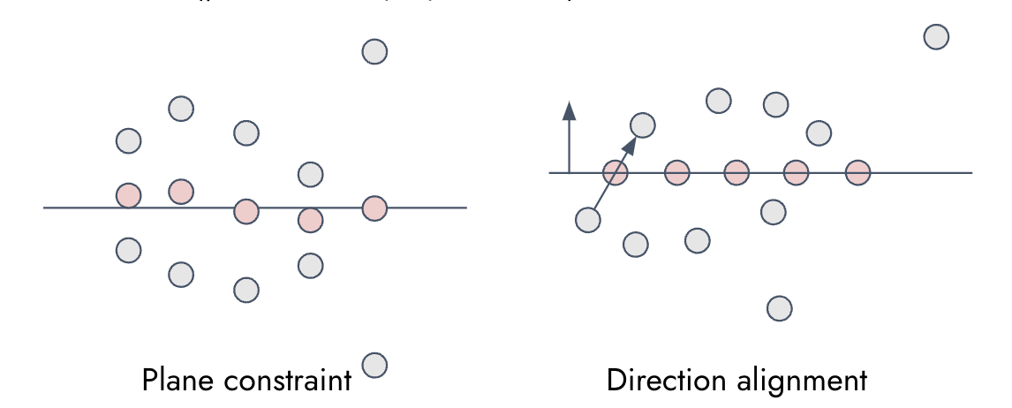
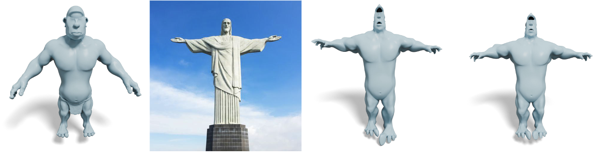
Symmetry Regularization
Symmetry detection
Sum of distance between mesh vertices and the mirror-reflected vertices’ nearest vertices is below threshold (reflection plane: passing object center & normal=principal axis)
Symmetry regularization consists of two terms
Midpoints deviation from reflection plane
Directional vector deviation from plane normal

Slide 15
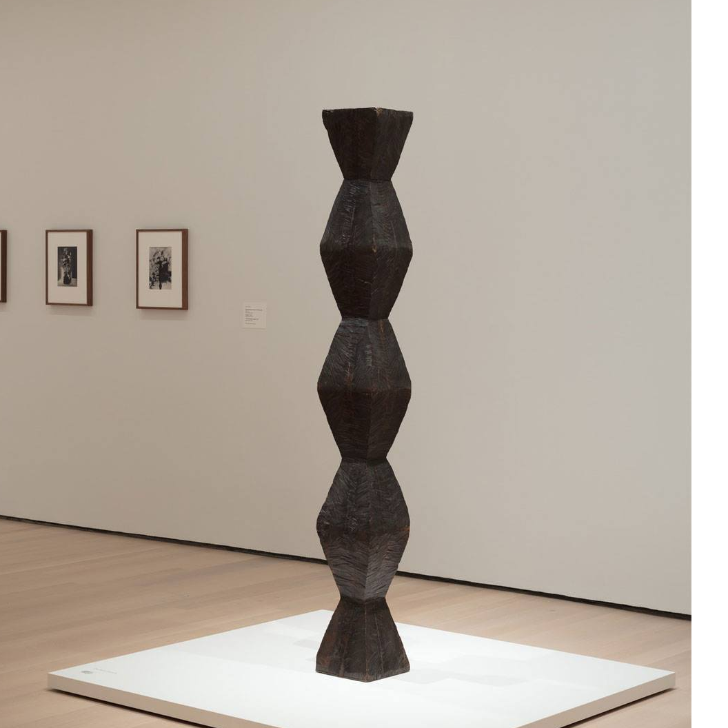
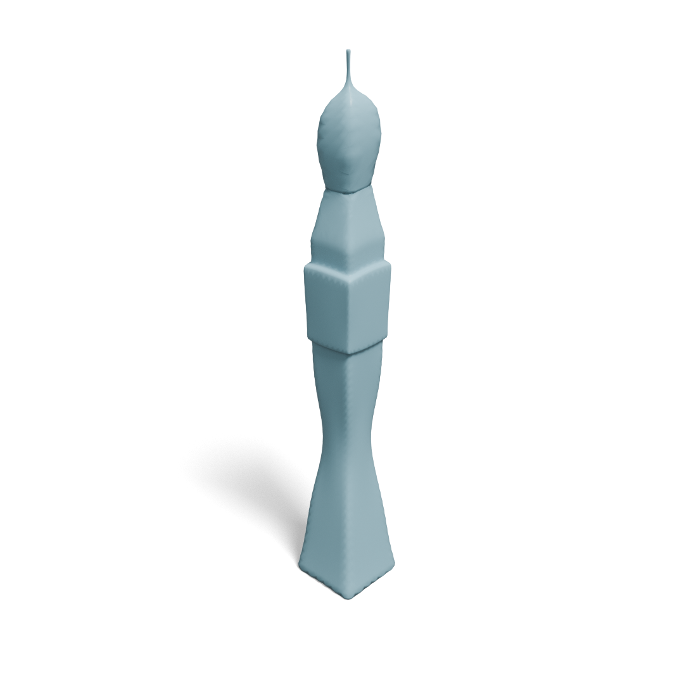

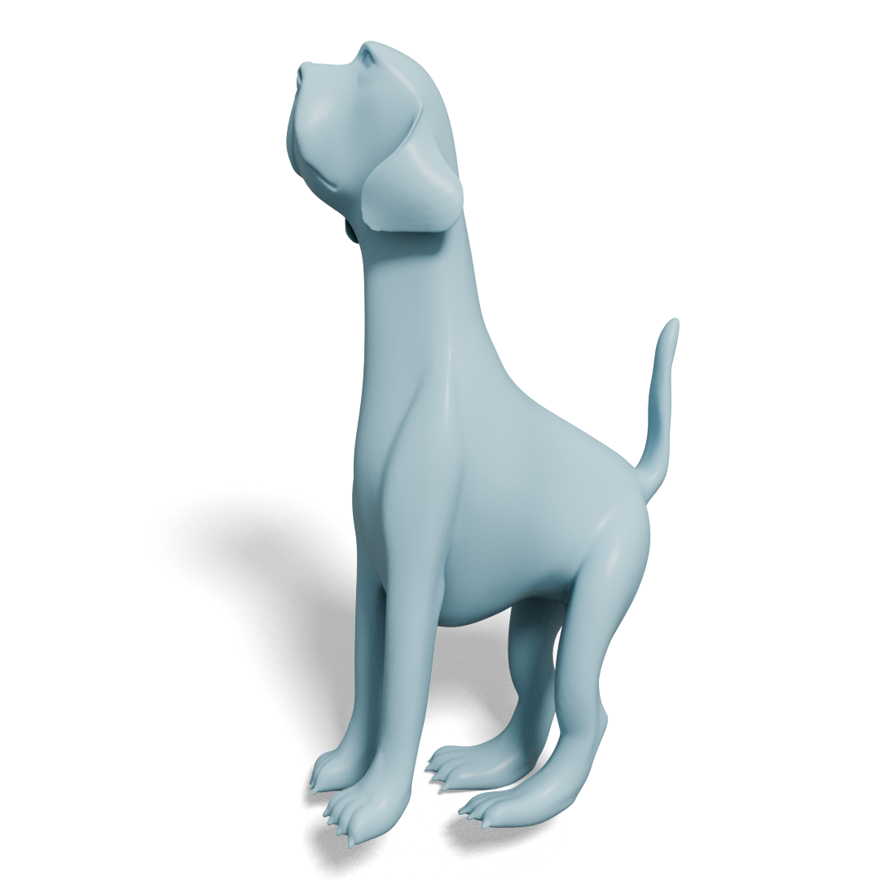

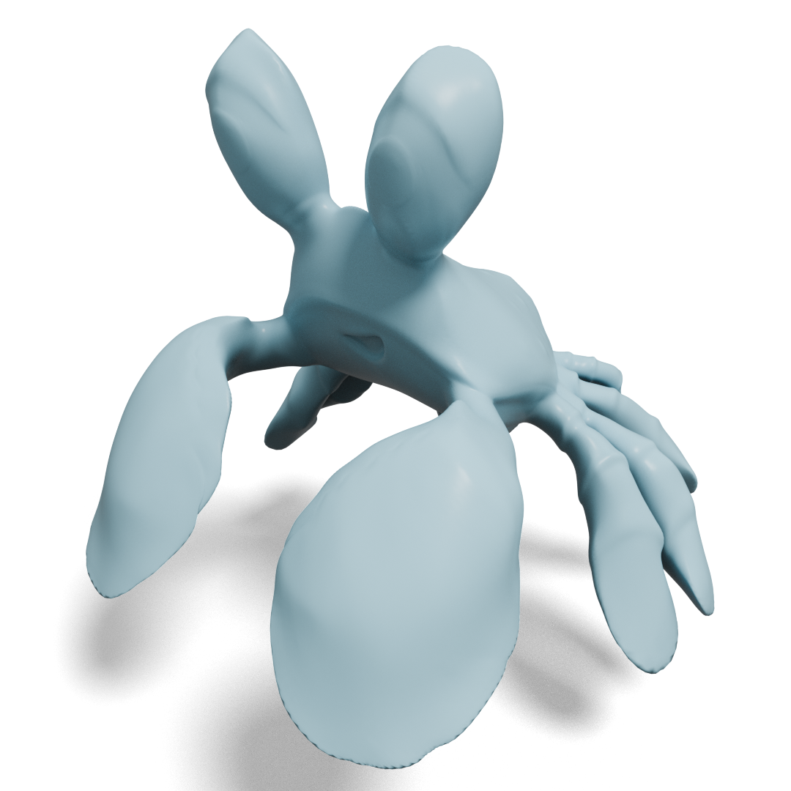
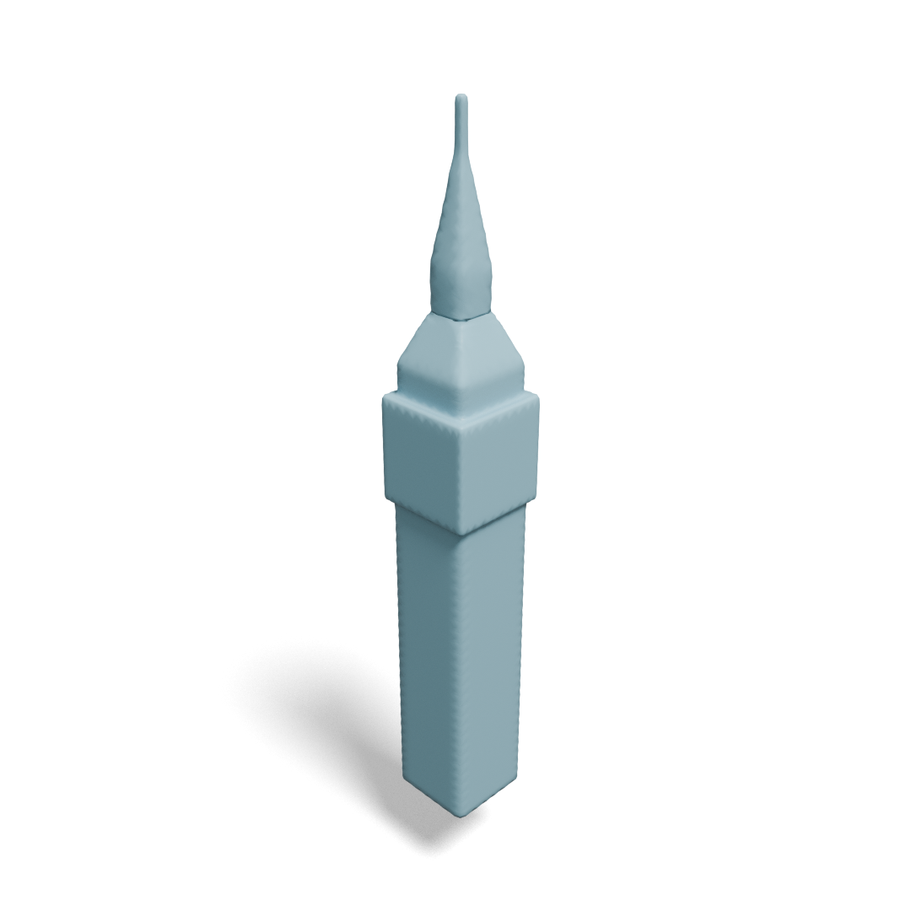

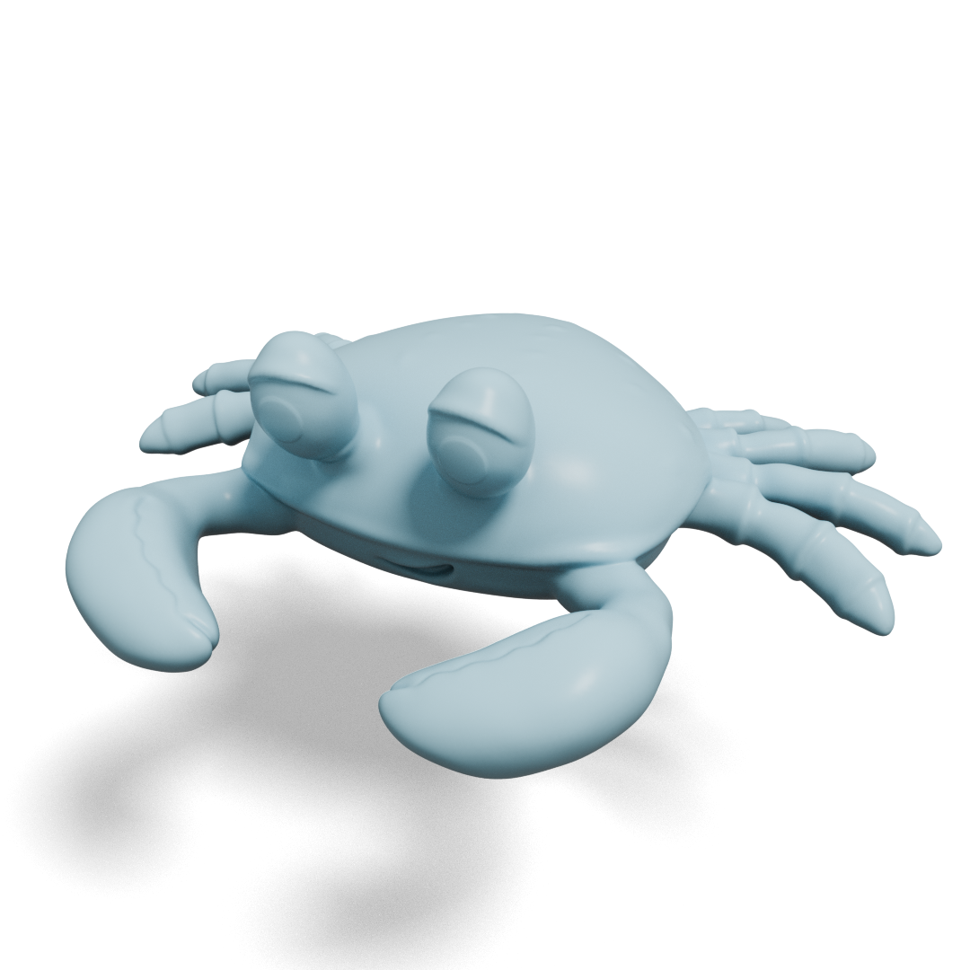
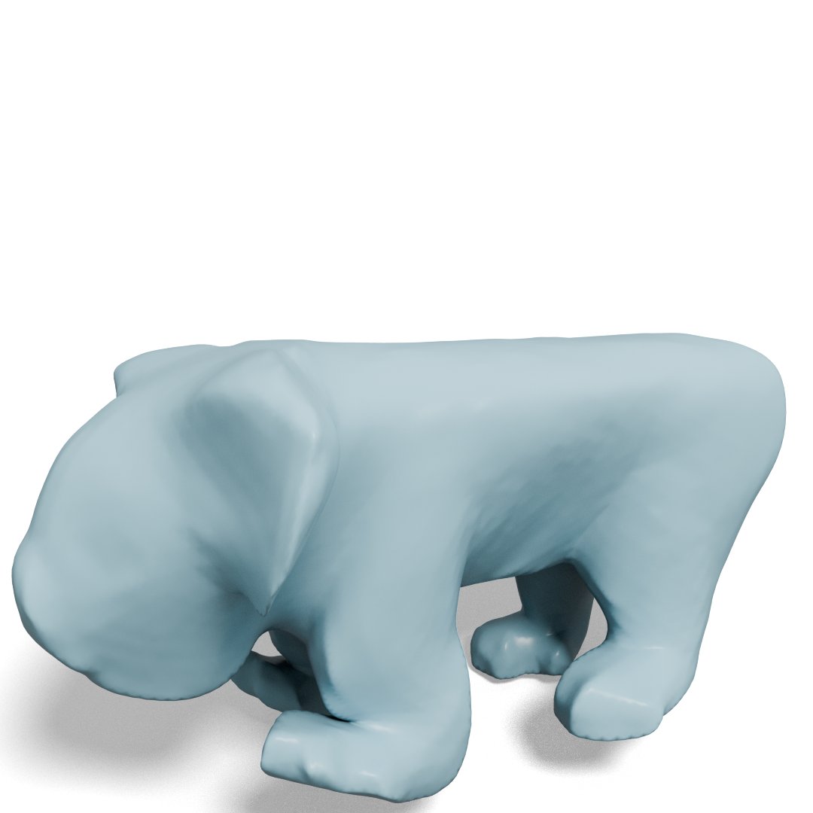

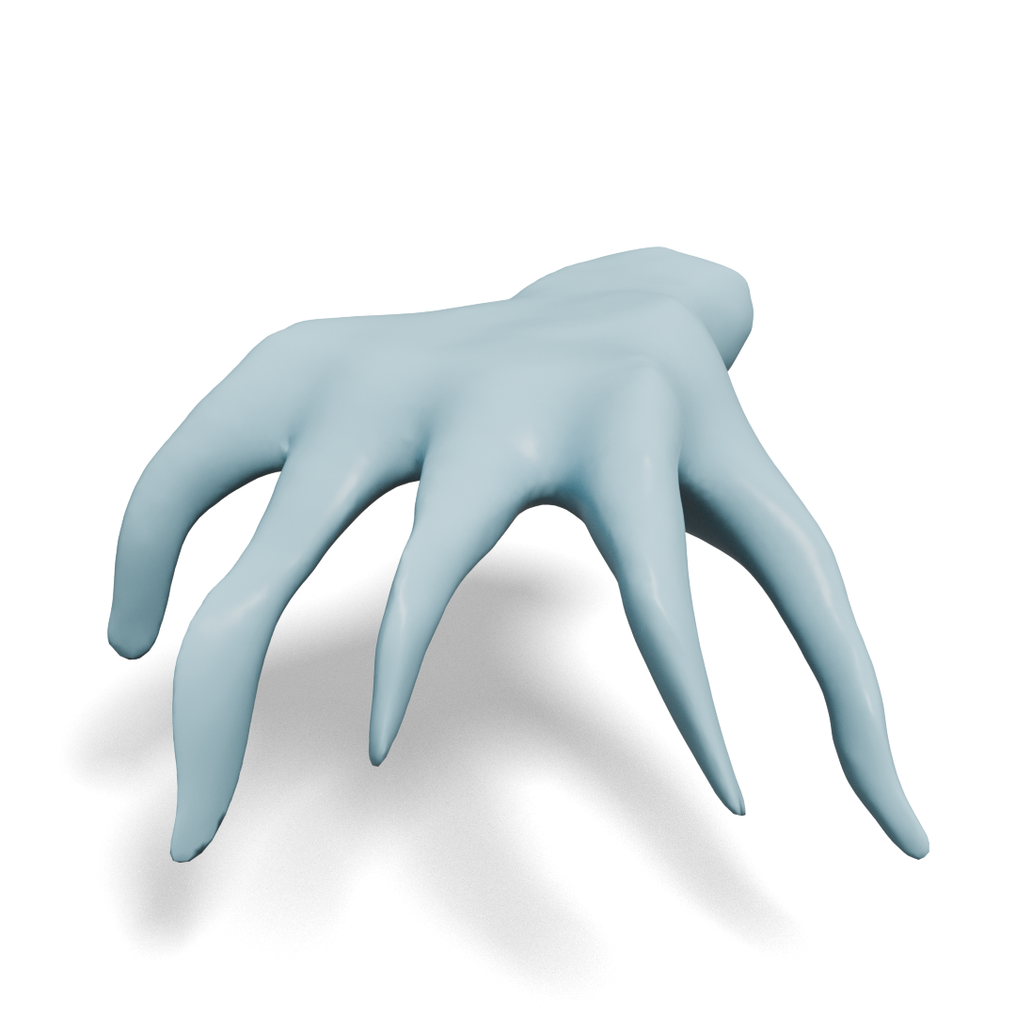

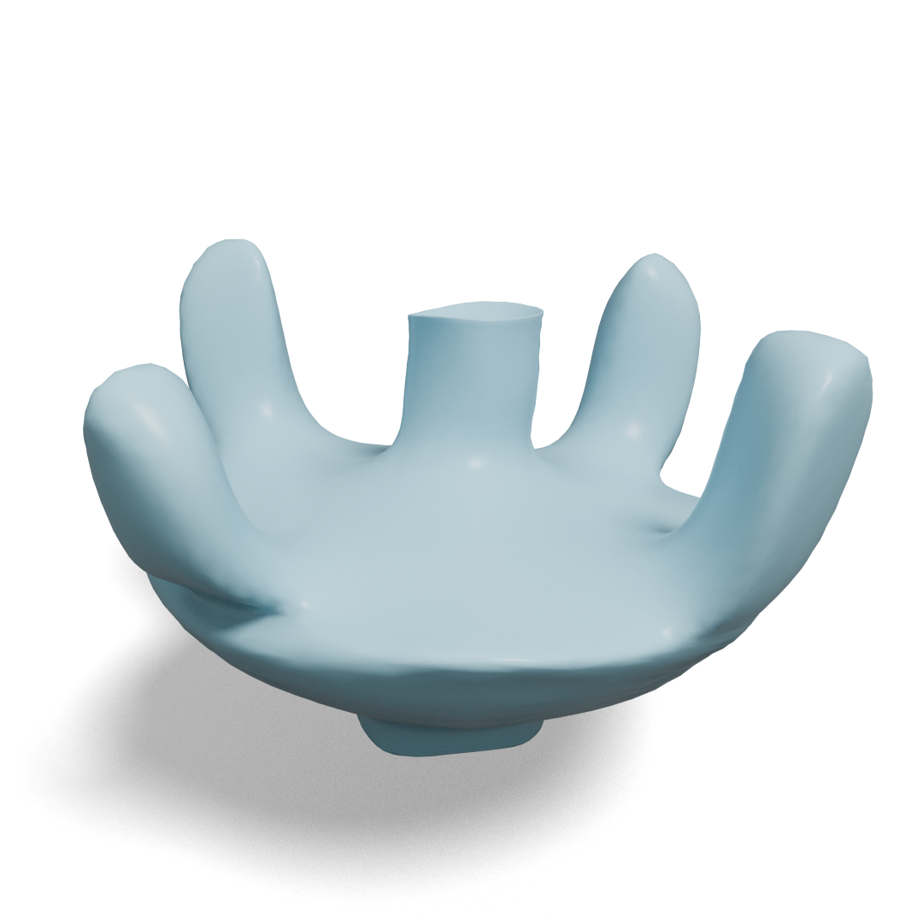
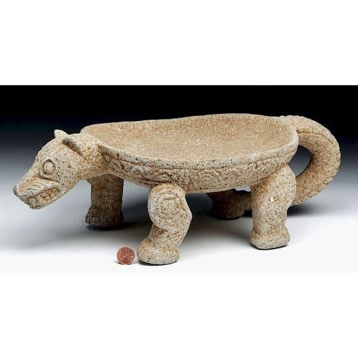
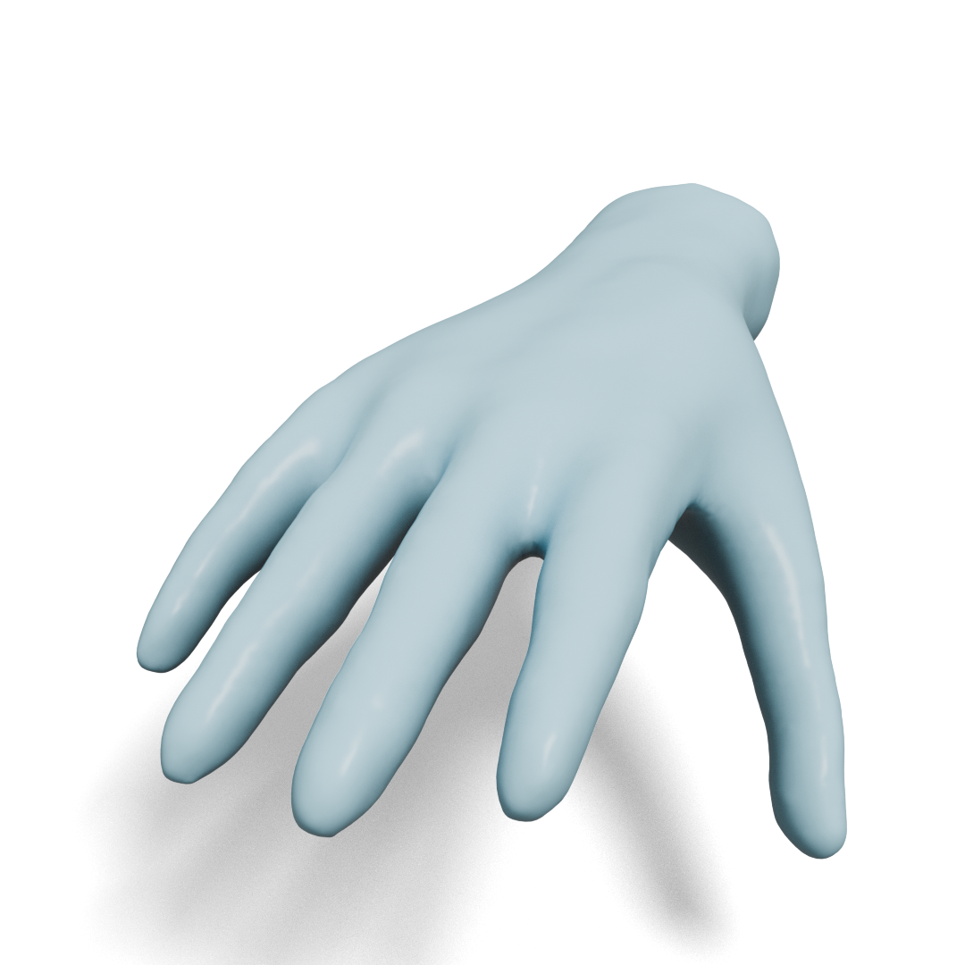
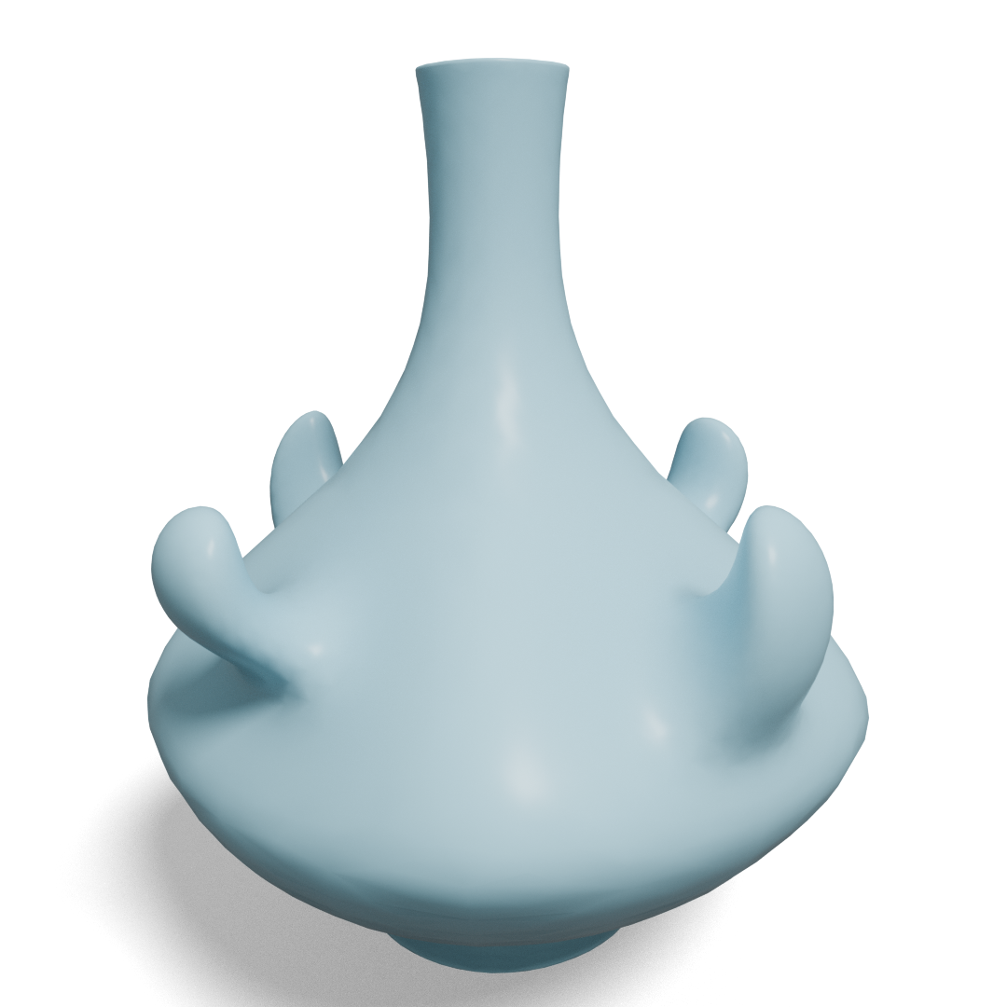
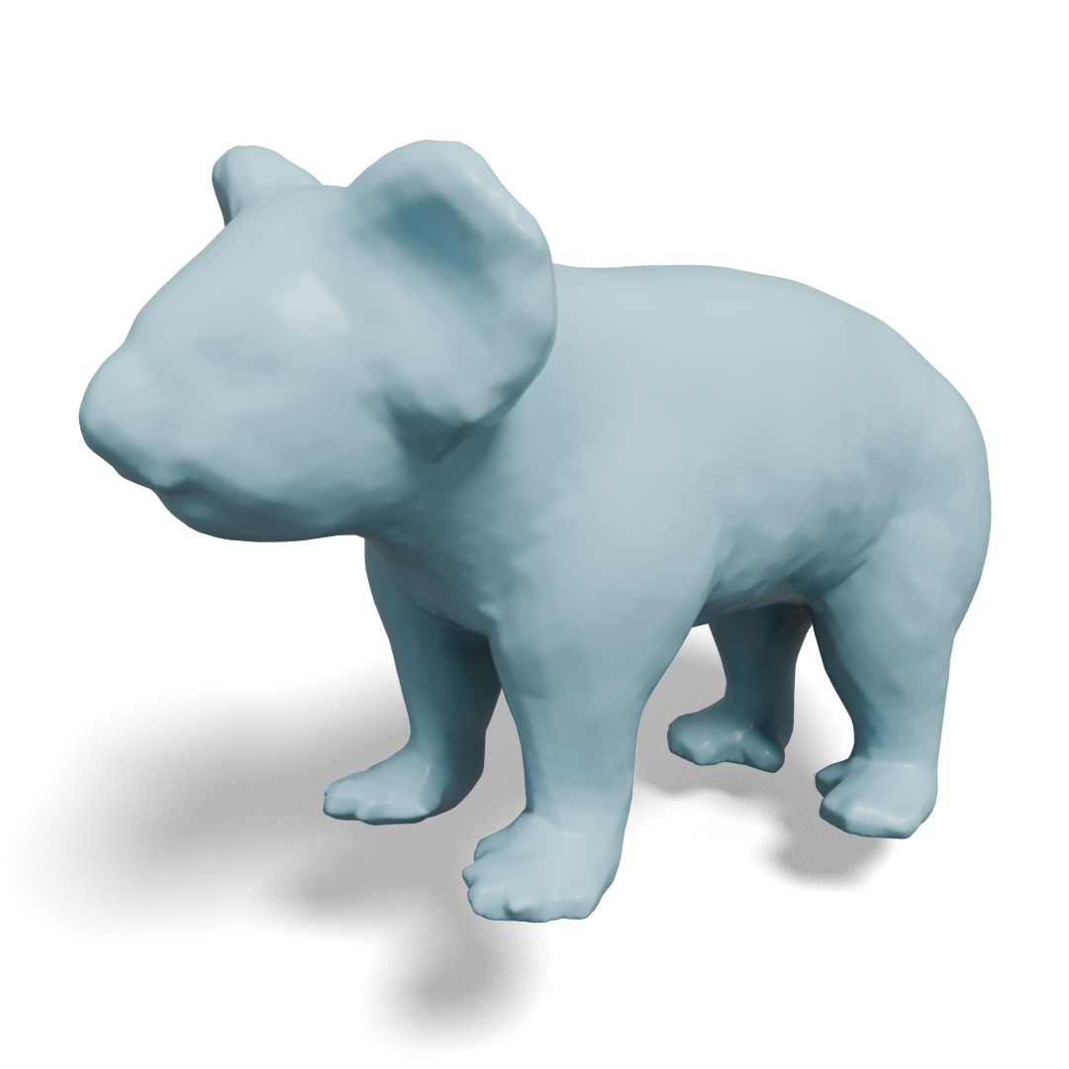
Qualitative Results

Slide 16
Qualitative Results – Baseline Comparison

Slide 17
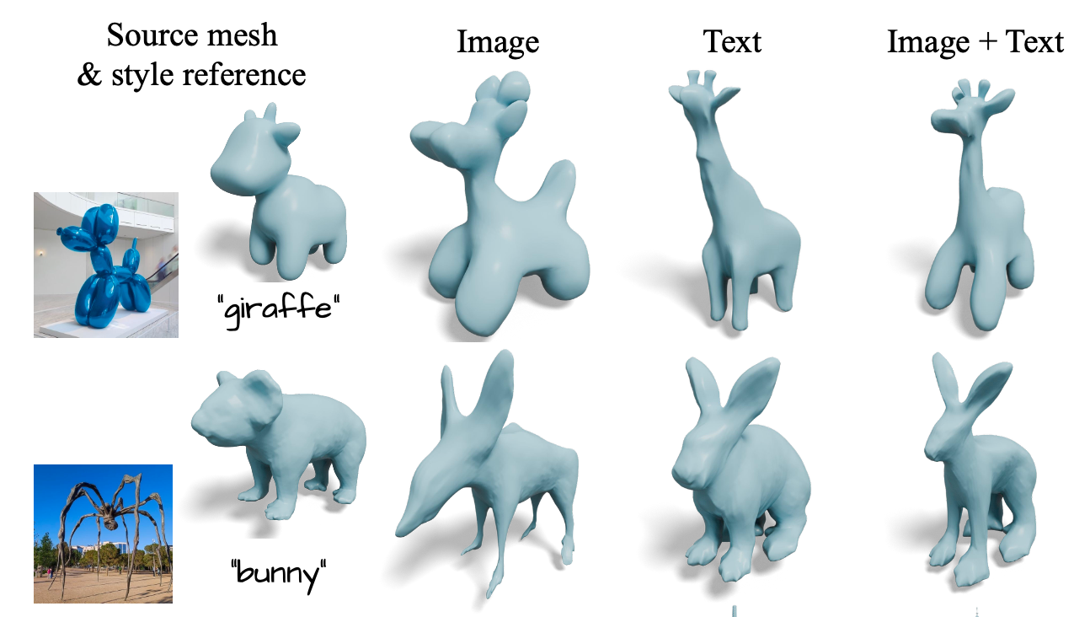

Additional Results
Geometric stylizaiton with text condition
Localized deformation

Slide 18

Conclusion
Personalized diffusion model is not only able to generate images of certain instance, but it can serve as a style-specific optimizer with SDS loss
Enable to embrace arbitrary styles!
Approximating encoder (and possibly decoder) of VAE of latent diffusion model is an efficient way to calculate SDS loss
Part-wise cage regularization and symmetry regularization are effectively preserves the semantics of the source mesh
Project page

